Slide 1
CS 4530 Software Engineering
Lecture 12.1: Engineering Software for Equity
© 2022, released under CC BY-SA

Slide 2
Learning Objectives for this Lesson
By the end of this lesson, you should be able to…
Suggest some ways in which software can cause inadvertent harm or amplify inequities, with examples
Explain why the software engineer has a powerful role to play in avoiding such harms.

Slide 3
From SE @ Google:
As new as the field of software engineering is, we’re newer still at understanding the impact it has on underrepresented people and diverse societies. … [We must recognize] the increasing imbalance of power between those who make development decisions that impact the world and those who simply must accept and live with those decisions that sometimes disadvantage already marginalized communities globally.
Notes:
This is a particularly important topic for a class on software engineering, as there is an enormous imbalance of power between those of us who make software development decisions, building software that’s used broadly, and the rest of the world that simply must accept and live with those decisions. As software engineers, you will likely wield more power than you realize.

Slide 4
A good software engineer will recognize potentials for inequity from their software.
“One mark of an exceptional engineer is the ability to understand how products can advantage and disadvantage different groups of human beings. Engineers are expected to have technical aptitude, but they should also have the discernment to know when to build something and when not to."
-Demma Rodriguez, Head of Equity Engineering @ Google
Quote: “Software Engineering at Google: Lessons Learned from Programming Over Time,” Wright, Winters and Manshreck, 2020 (O’Reilly)
Notes:
Being an exceptional engineer means not only know HOW to build some killer features, but that you have the judgement to be able to identify and reject features or products that drive adverse outcomes.

Slide 5
Algorithmic sentencing systems can discriminate against Black defendants
Example: the COMPAS Sentencing Tool
 | ALL DEFENDANTS | WHITE DEFENDANTS | BLACK DEFENDANTS
Labeled Higher Risk, But Didn’t Re-Offend | 32.4% | 23.5% | 44.9%
Labeled Lower Risk, Yet Did Re-Offend | 37.4% | 47.7% | 28.0%
Analysis of Broward County, FL data: “How We Analyzed the COMPAS Recidivism Algorithm” by Jeff Larson, Surya Mattu, Lauren Kirchner and Julia Angwin
Notes:
For example: some states use software to assess a criminal defendant’s likelihood of recidivism - a term used to describe criminals who are likely to re-offend. This prediction is used in pre-trial bail hearings, and also in sentencing, where the goal is to assign longer sentences to those most likely to commit another crime. It is likely not unreasonable to be concerned that some judges might be biased against certain defendants, and assign harsher sentences based on those biases. If computers can accurately predict which defendants are likely to commit new crimes, we could potentially reduce bias in our criminal justice system.
Here are the results of an evaluation of one model, the COMPAS Sentencing Tool in Broward County, Florida.
The percentage of false positives and false negatives was roughly 30% in both ways (not great, in any case!)
But if you break down this data by race, you see that black defendants are far more likely to be falsely labeled as high risk than are white defendants. (And vice versa: white defendants are far more likely to be falsely labeled as low risk)
When building such tools, it’s vital to evaluate them on multiple dimensions to ensure that we are not simply re-enforcing existing biases.

Slide 6
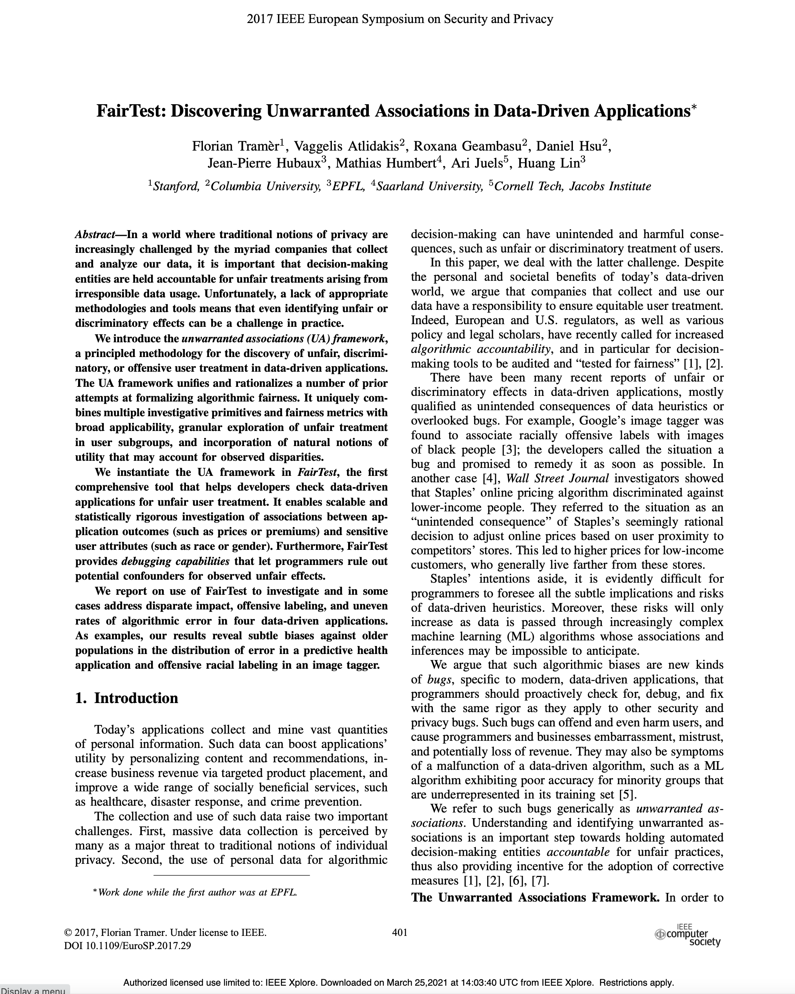
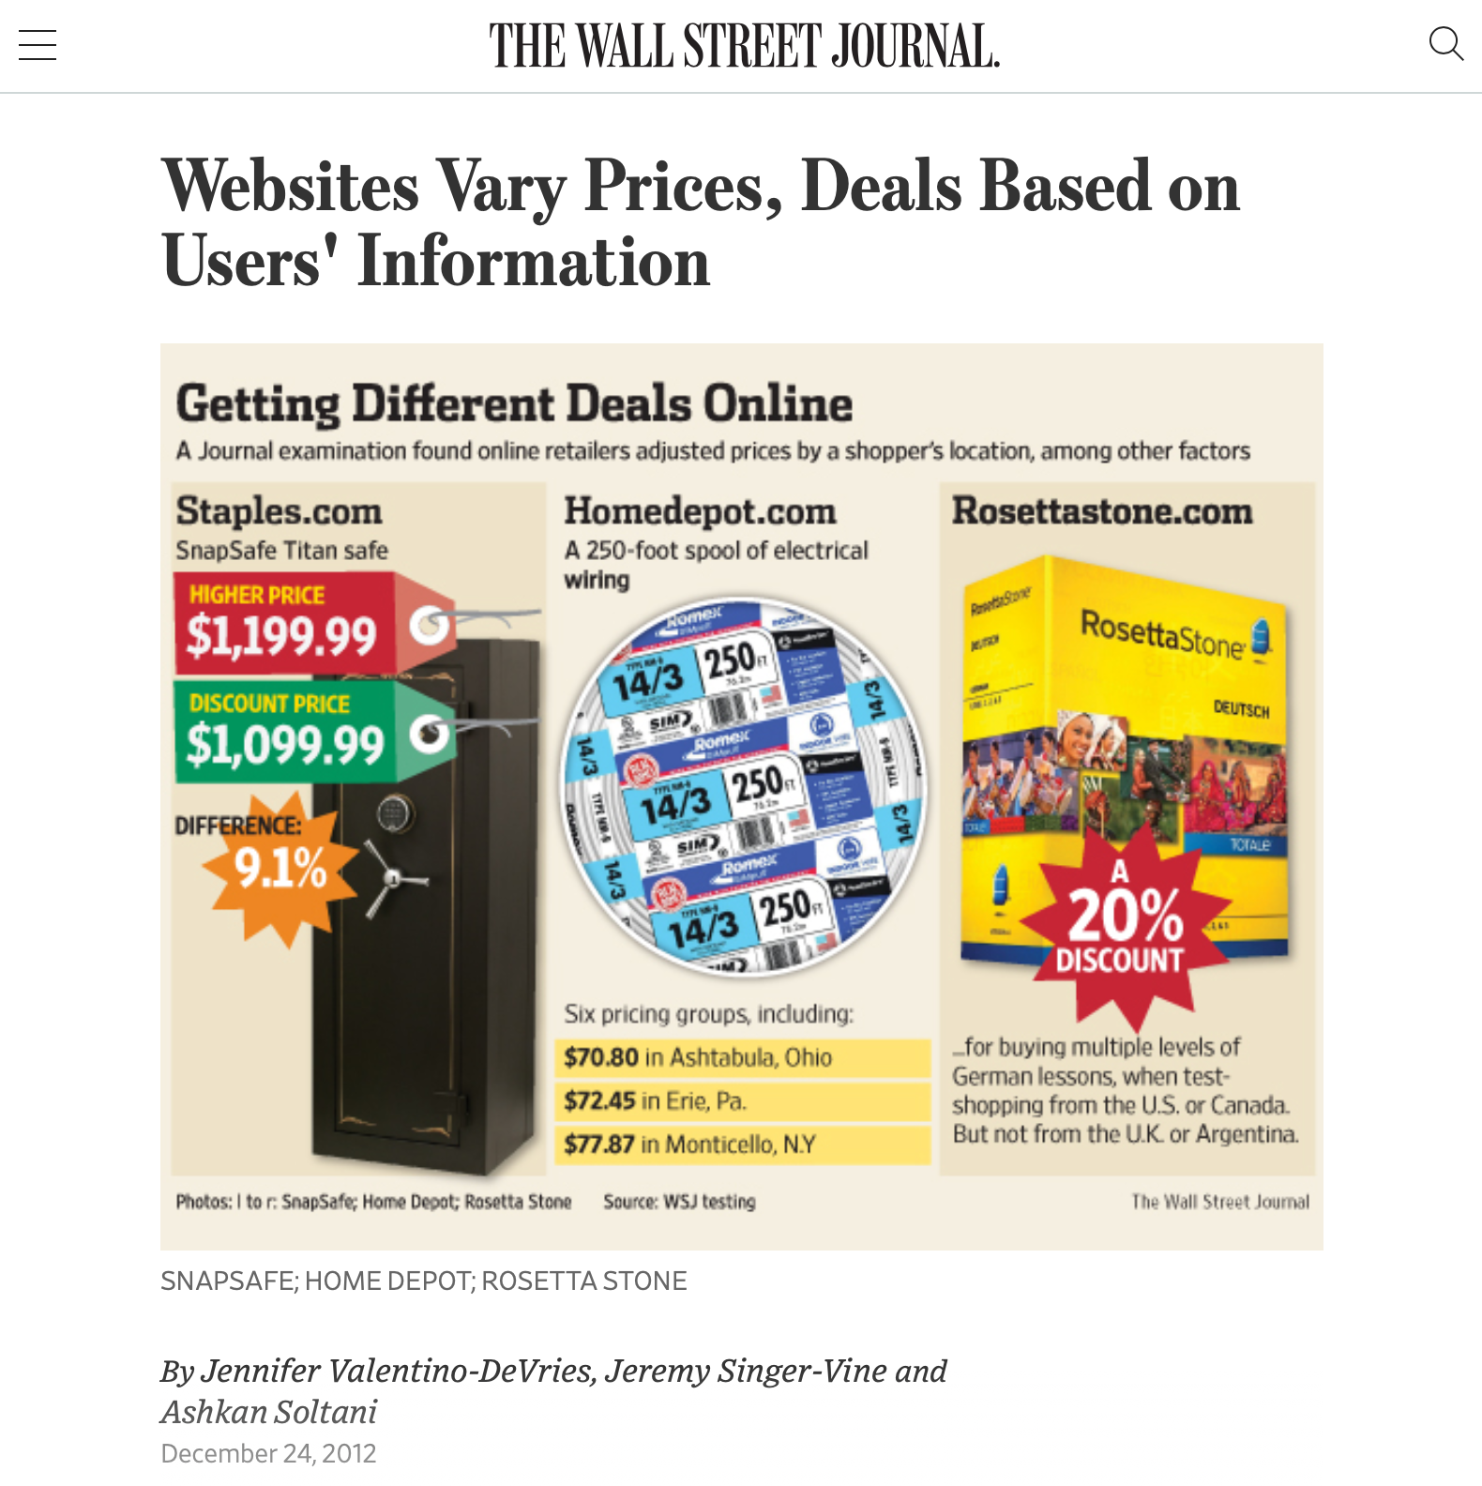
Algorithmic bias can discriminate against poorer consumers
https://www.wsj.com/articles/SB10001424127887323777204578189391813881534
Notes:
Algorithmic bias is all too easy to introduce - it is often easy to overlook hidden correlations between inputs that we feed into our algorithms and real world attributes. For instance: price discrimination and price steering are techniques that dynamically show a different price for the same good or service to different users. For example: Staples, OfficeMax and OfficeDepot compete to sell the same products to the same customers. If I’m Staples, and I’m trying to draw customers who might otherwise go to one of my competitors, I might say something like… “If you live within 20 miles of OfficeMax or OfficeDepot, you will see a cheaper price, otherwise you’ll see more.” This could let me drive revenues: customers who would have gone to a competitor see my low prices, customers who don’t have an alternative will pay the slightly higher price anyway.
On the surface, this sounds fine. But: what if OfficeMax + OfficeDepot are primarily located in wealthy areas? If so, then our policy is actually saying: on the whole, charge wealthy customers less than poor customers. Whether this is an OK policy or not is a topic for a class on business ethics - what our interest as software engineers is is simply in recognizing that this could be an unintended harm.

Slide 7
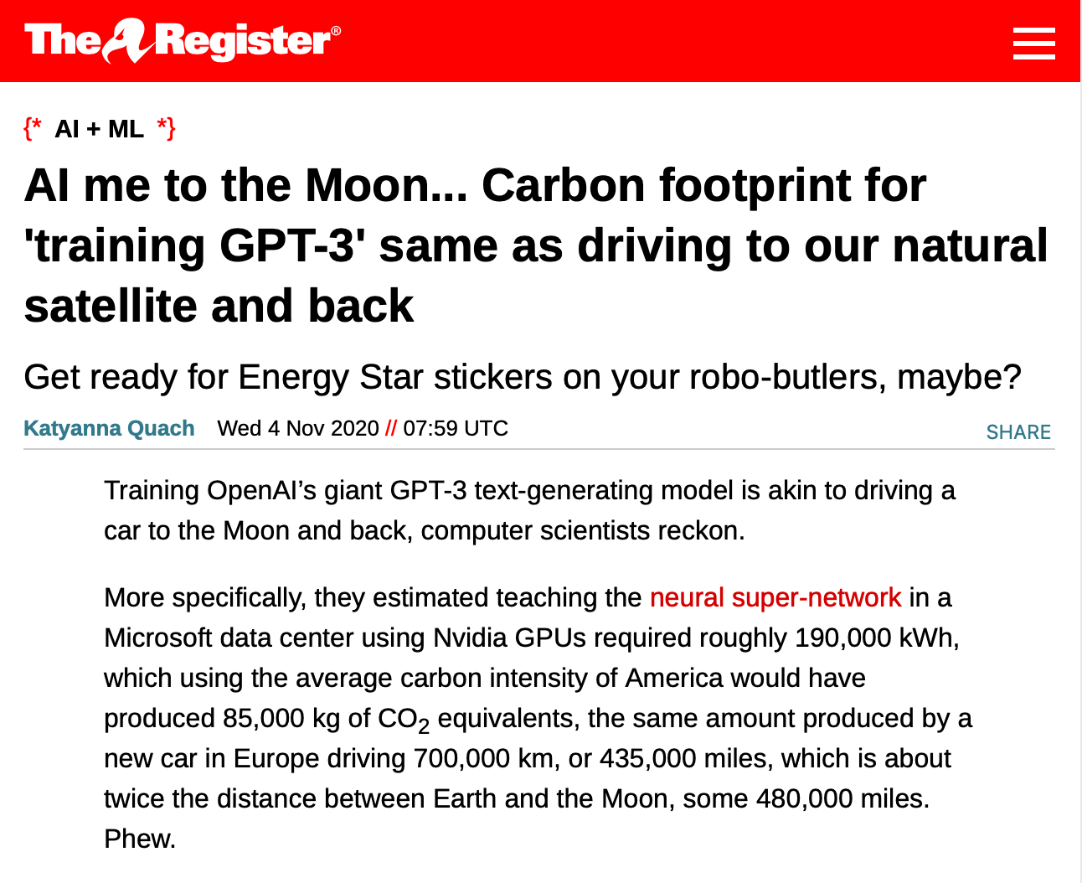
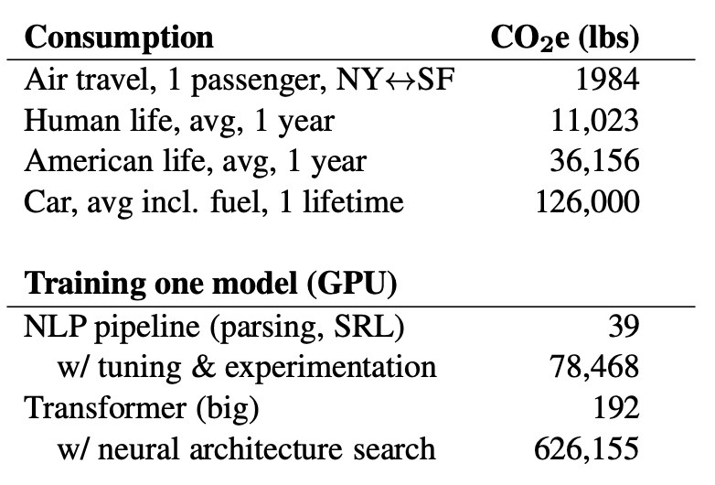
Training AI systems can have serious impacts on climate.
Not to mention bitcoin mining!
“Energy and Policy Considerations for Deep Learning in NLP” Emma Strubell, Ananya Ganesh, Andrew McCallum, in Proceedings of ACL 2019
https://www.theregister.com/2020/11/04/gpt3_carbon_footprint_estimate/
Notes:
As we build more and more complex software and in particular, machine learning models, it is also becoming increasingly important to quantify the climate impact of our software. For example, consider training GPT-3, which is the huge text-generation model that lets gmail/google docs auto-complete your sentences and write entire documents for you. The power consumption of the training process was equivalent to driving a car for 435,000 miles. Other studies have pointed out that in training and developing models, there’s often an even greater carbon impact. Again, this is not to say that we shouldn’t create machine learning models, but rather, simply to point out that this may be an unintended harm.
And Machine Learning is not the only application that uses huge amounts of energy (click)
Once we recognize the potential for harm, we can consider mitigation steps like locating our data centers in regions that provide for cheap renewable energy and cooling.

Slide 8
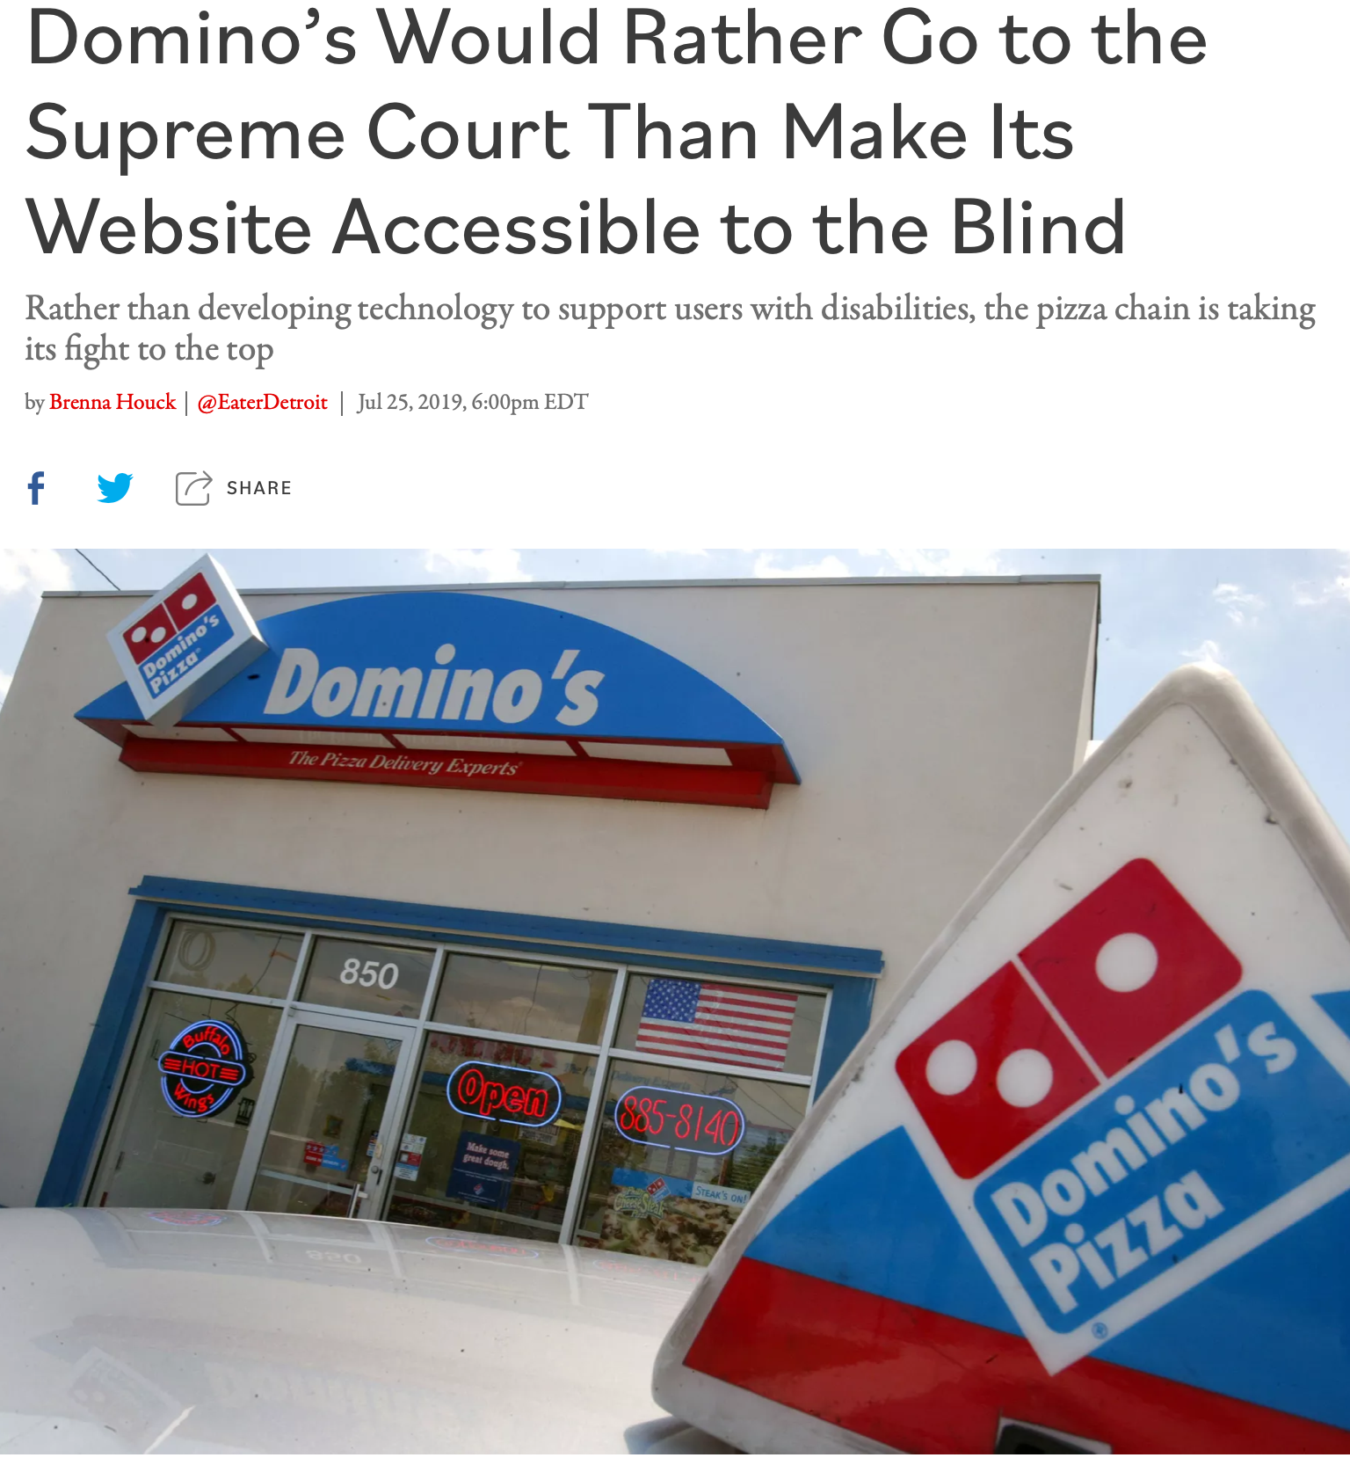
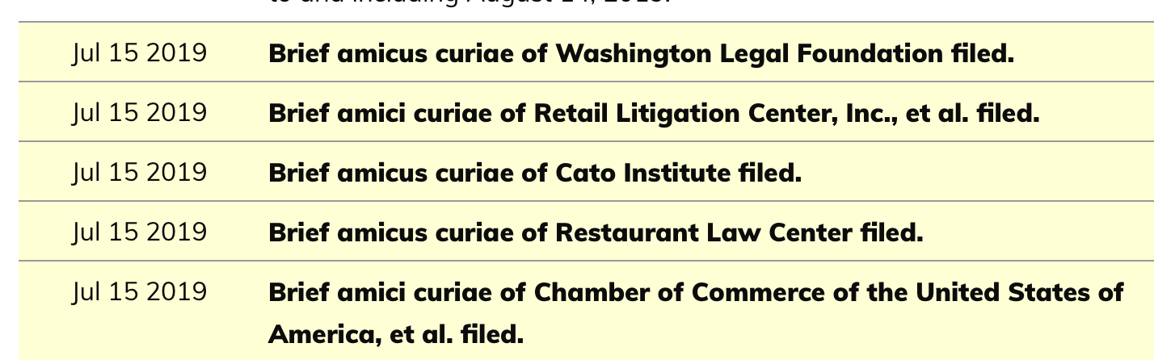
Poor user interfaces can discriminate against differently-abled people.
Inclusivity and Accessibility: Domino’s Pizza LLC v. Robles
“Domino’s Would Rather Go to the Supreme Court Than Make Its Website Accessible to the Blind” by Brenna Houck, Eater Detroit
Notes:
There are also very direct ways that we can inadvertently construct software that is not inclusive of all of our users. For instance: is our software accessible to users who have disabilities, such as being blind or low-vision? The Americans with Disabilities Act requires that public places must be accessible to people with disabilities. In 2019 a blind man sued Domino’s for not providing an interface for ordering pizza that was compatible with screen-readers, which is a kind of technology that is key to making computer accessible to the blind.
Dominos argued that the ADA only applies to physical interactions, since it was written before Internet, so how are we supposed to know what an accessible website is? The question brought before the supreme court, was, basically: do online retailers need to provide an accessible website? Many within the retail and restaurant industries filed amicus briefs backing Domino’s, stressing the “impossibility of guessing what accessibility means in the online environment.” The supreme court found that the ADA applies to websites, too. We’ll come back to this example in our next lesson.
http://jlsp.law.columbia.edu/2020/02/13/inaccessible-pizza-delivery-and-the-future-of-the-ada/

Slide 9
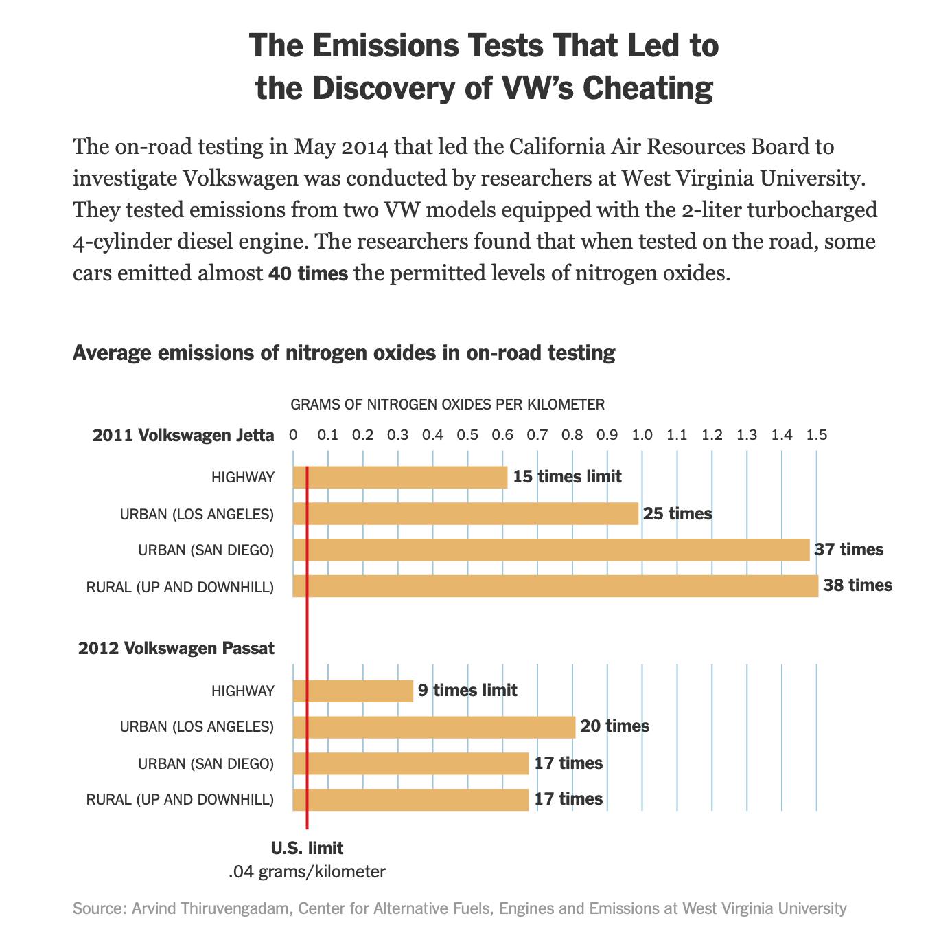
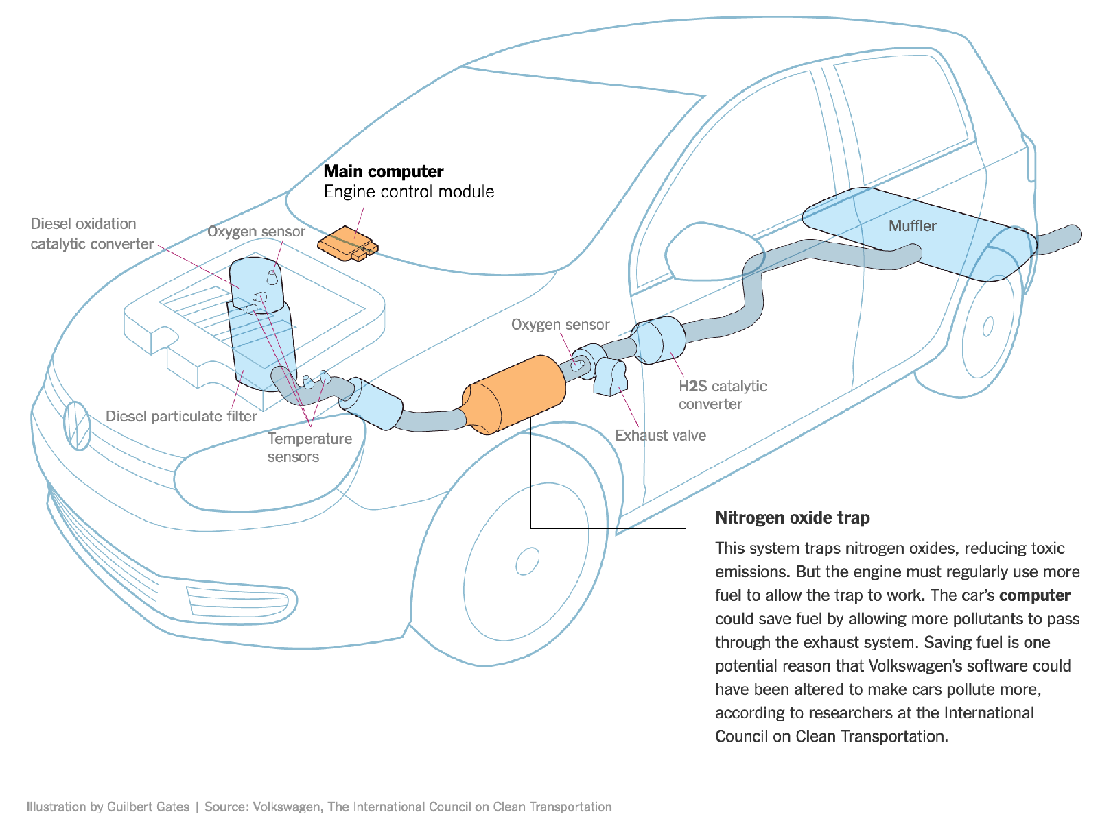
Software Systems can be used to evade regulation.
Example: Volkswagen diesel emissions
$14.7 billion settlement
“How Volkswagen’s ‘Defeat Devices’ Worked” By Guilbert Gates, Jack Ewing, Karl Russell and Derek Watkins
Notes:
It’s hard to talk about engineering equitable software and not bring up the Volkswagen emissions testing defeat device. If you’re not familiar with this scandal: cars are held to a particular emissions standard. Particularly in diesel cars, reducing emissions often tracks with reducing performance. Again, the question of “how much emissions are too much, if any” is out of scope for this discussion, and instead, we’re focusing on the regulations that existed at the time of this scandal. Cars are tested for this emissions standard in off-road simulators, where they can be easily hooked up to equipment that directly measures their emissions. Volkswagen’s engine control unit had customized software to detect when the car was under an emissions test and tune the engine to reduce performance and emissions, resulting in emissions tests that significantly under-represented the actual emissions of the vehicle. (Click) This software mislead regulators and consumers, and ultimately Volkswagen agreed to spend $14.7 billion in a settlement, and was subject to significant public relations damage.

Slide 10
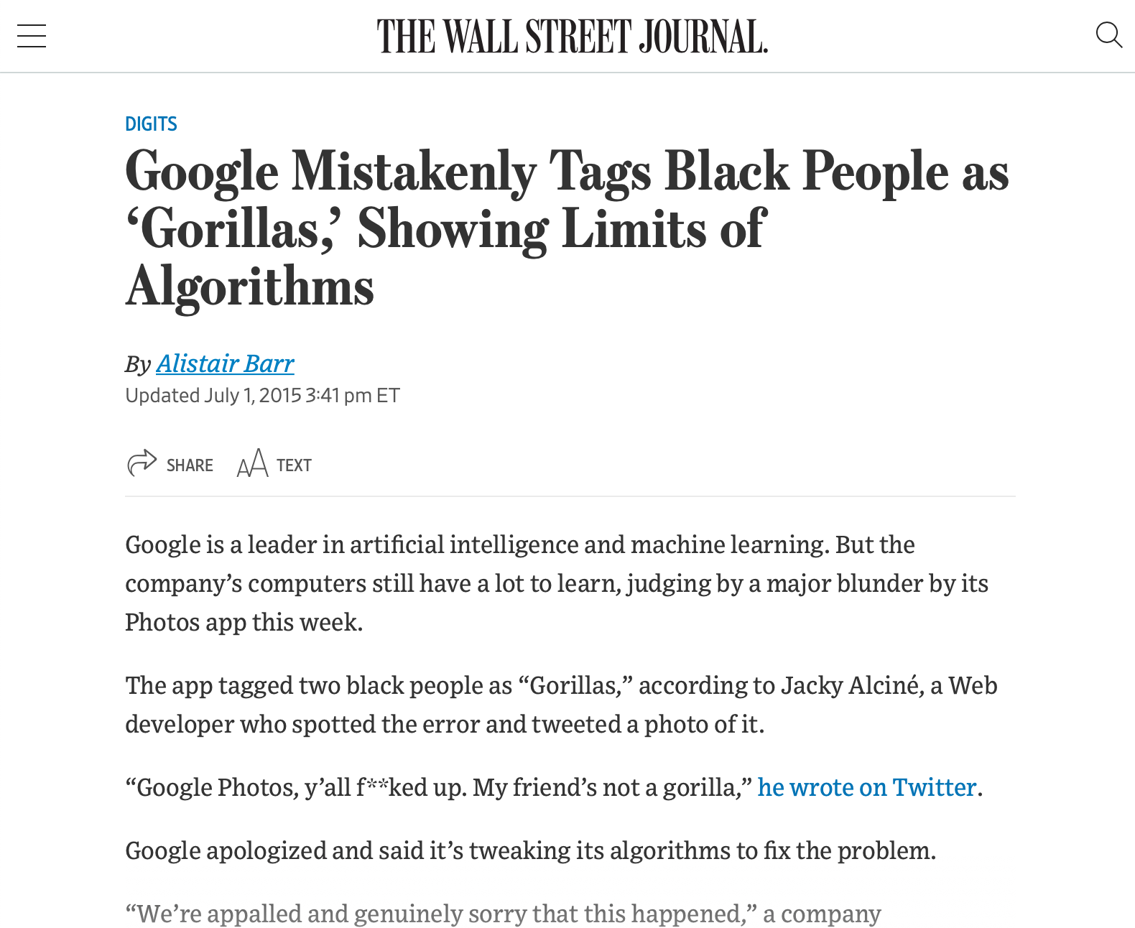
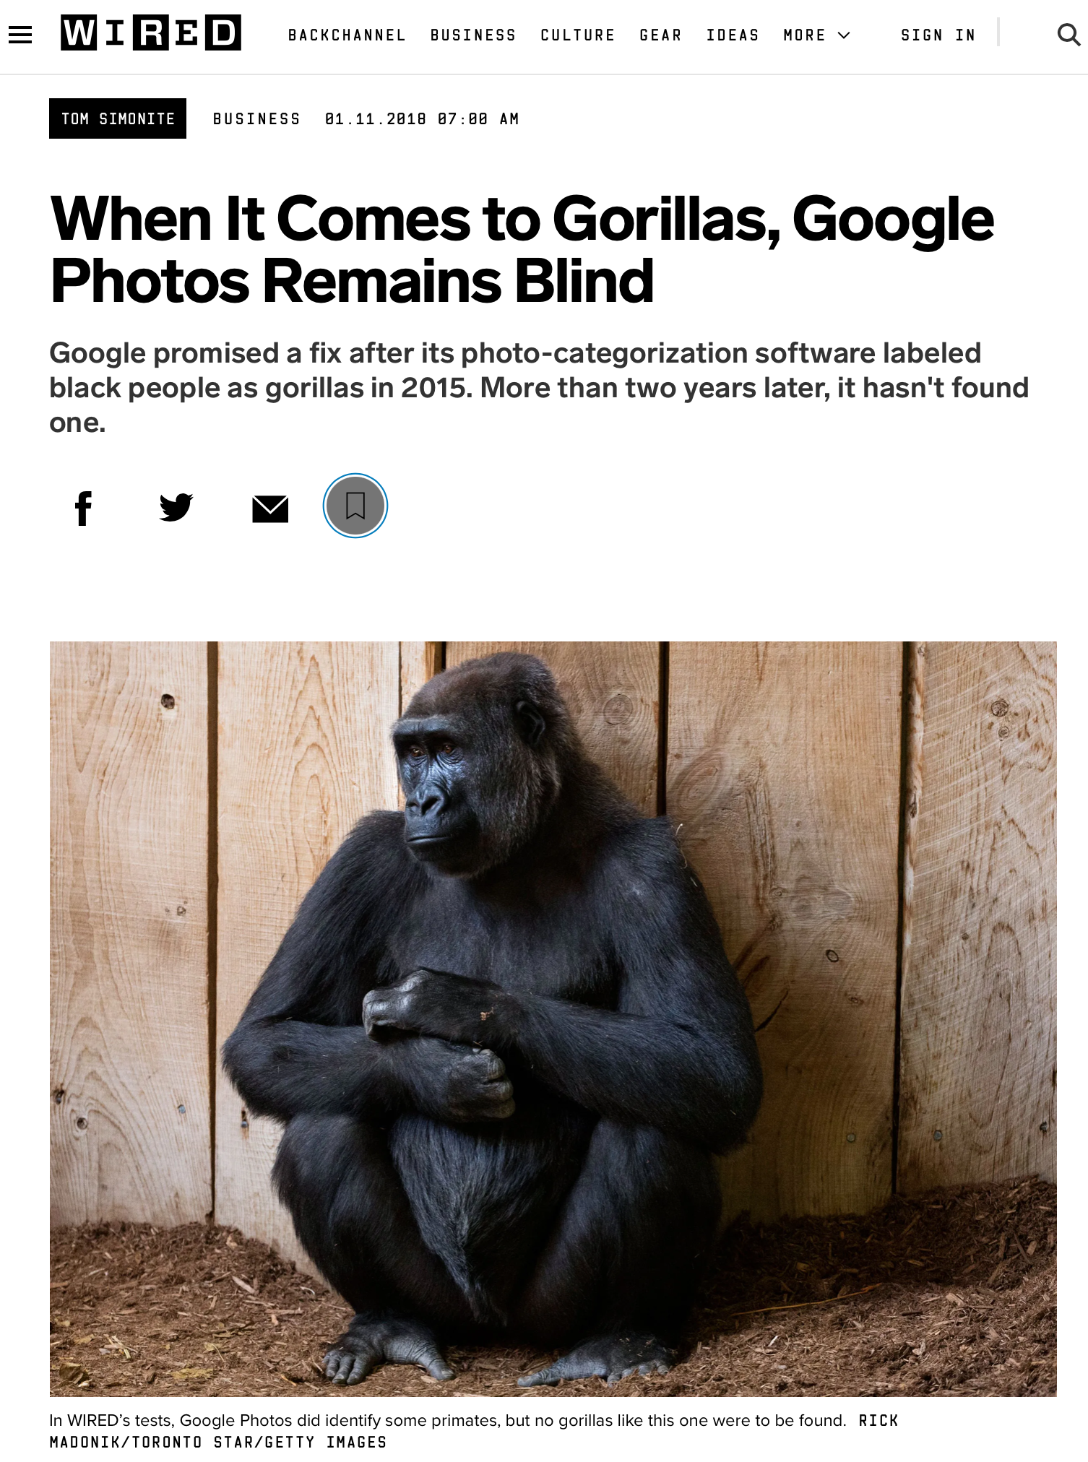
Bias is the Default
Example: Google Photos auto-tagging (2015)
https://www.wsj.com/articles/BL-DGB-42522
https://www.wired.com/story/when-it-comes-to-gorillas-google-photos-remains-blind/
Notes:
As a case example of bias as the default, consider this incident from 2015, when google released a new photo tagging feature in Google Photos, which was prone to misidentify black people in photographs as gorillas. How did this happen? Image recognition algorithm depend on being supplied a proper (complete) dataset - clearly an incomplete dataset, not representative of entire population. Why didn’t this come up in internal testing? To the extent that Google has a diverse development team today, that was much less true in 2015 - so nobody was trying it and finding this out, and the unconscious bias of the organization resulted in this product getting out. This was harmful both to users, and to Google’s reputation. Even today, this is not very well fixed - and is mostly side-stepped by not identifying any image as a gorilla. It’s useful to think of a case like this to set the tone for a conversation about diversity and inclusivity, but there are many more subtle biases in our software.

Slide 11
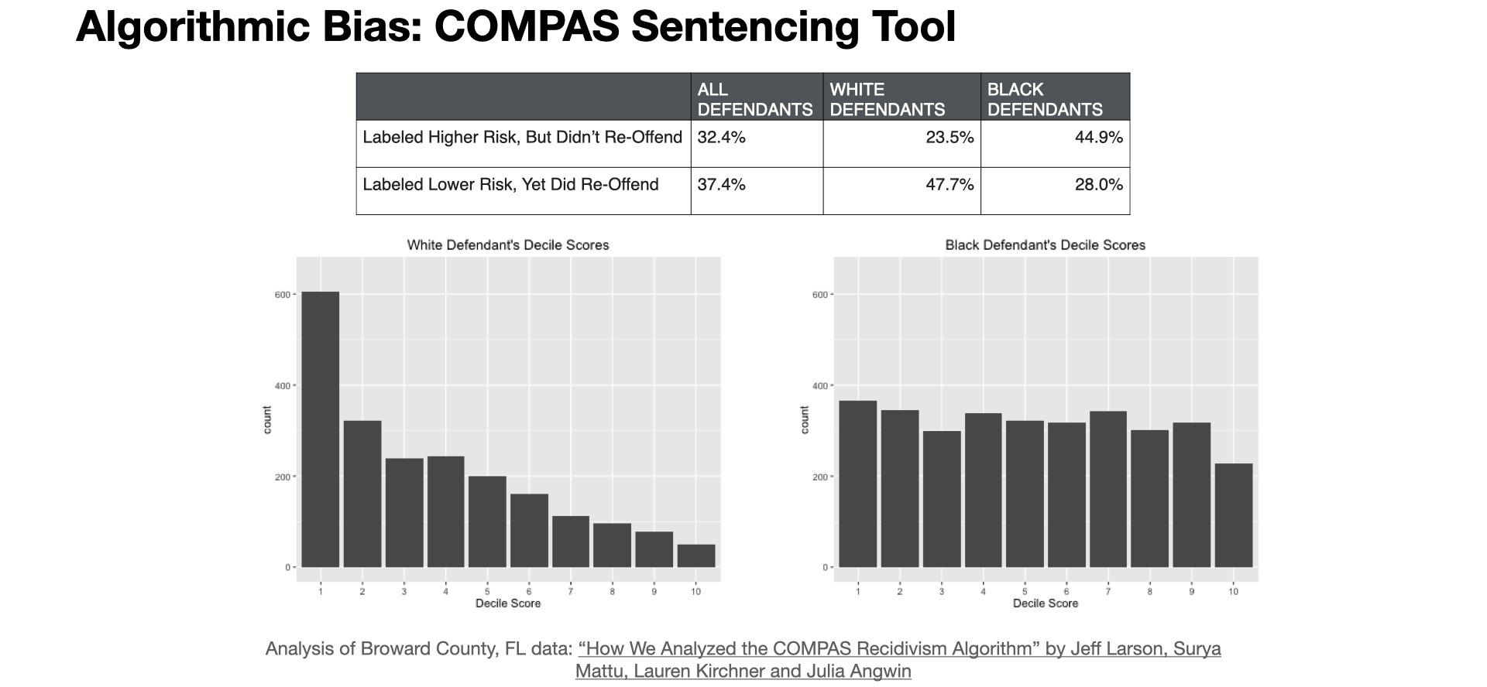
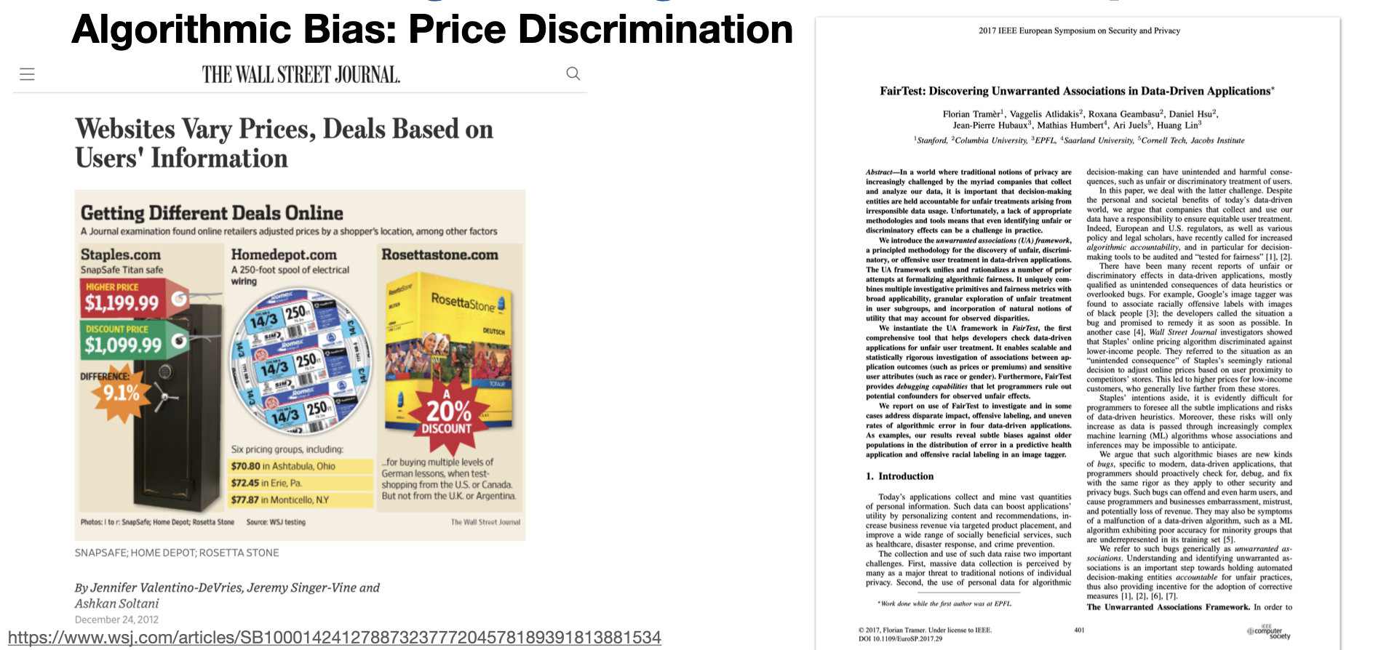
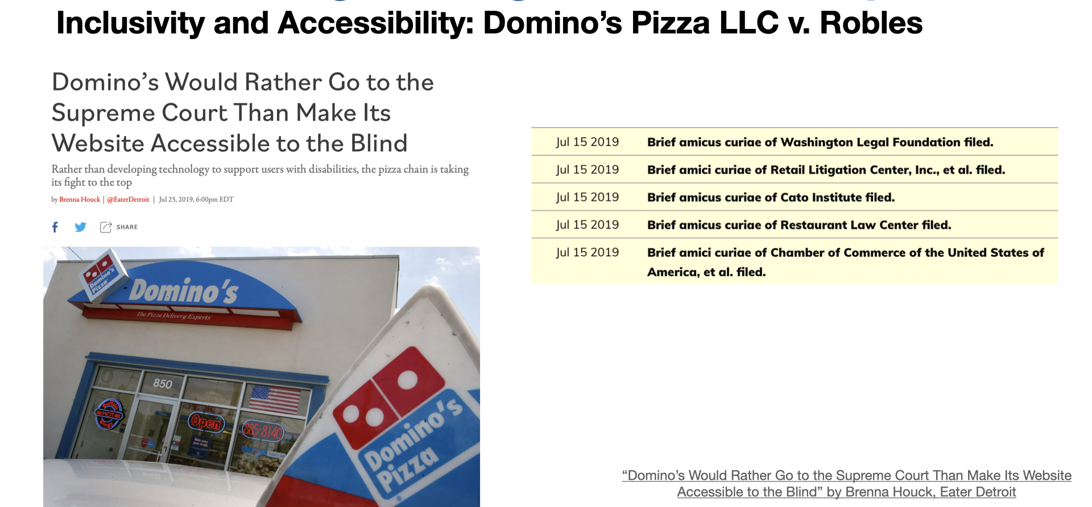
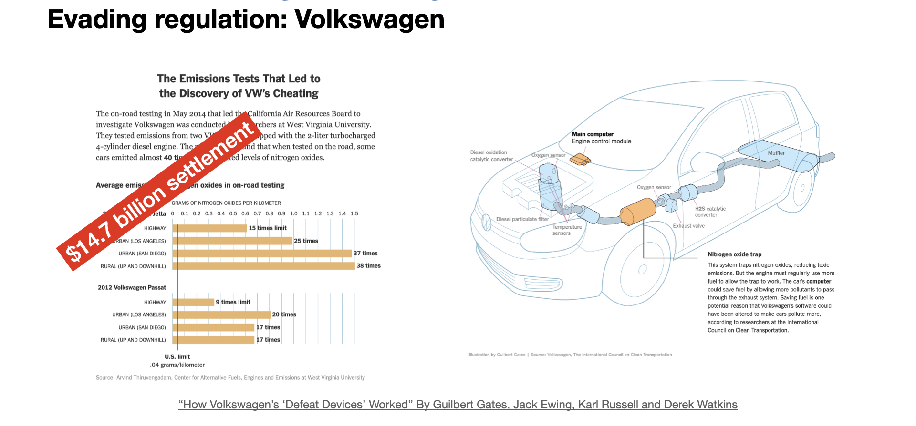
Reflecting on these examples
Personal philosophies and business cases
Notes:
Regardless of your personal ethical philosophy, and whether you think that it was OK or not for these companies to build these applications in these ways, I hope that we can all see a simple business case that argues for avoiding behaviors that will result in the kinds of negative public relations fiascos that these companies faced. Quite often when developing a product, we are faced with the choice of the fast option that provides inequitable outcomes.
Sometimes, making our software equitable simply means an additional set of implementation tasks - like making the dominos app work with a screenreader.
Other times, we may need to seriously examine the systems of inequality that our software is built on: how can we build a system to predict criminal recidivism if we acknowledge that the data that we base these models off of is inherently biased?

Slide 12
More than “don’t be evil”
Engineering equitable software requires conscious effort
How do we determine what “the right thing” is?
How do we convince our investors/managers to take this action?
Notes:
Engineering equitable software requires conscious effort. It is not simple enough to take on a motto like “don’t be evil” or “do the right thing,” when it is often difficult to fully comprehend the societal impacts of our technical decisions. Moreover, even when we do see a clear potential harm to some portion of the population, taking corrective action can be challenging.

Slide 13
This lesson was about the harms that software can inflict
You should now be able to…
Suggest some ways in which software can cause inadvertent harm or amplify inequities, with examples
Explain why the software engineer has a powerful role to play in avoiding such harms.

